Slide 1

An Automated COVID-19 SOPs Monitoring And Management System
GSN: FALL 21-18
Presented by:
Maaheen Yasin (L18-1267)
Inbisat Mudassar Dar (L18-1283)
Ahmad Tameem Kamal (L18-1358)
Advisor: Mr. Hamza Yousuf
Client: Saleem Steel Industries
Evaluation Committee:
Ms. Shazia Haque
Dr. Omer Saleem

Slide 2

Hardware Block Diagram of FYP
What is YOLO?
Why is YOLO importance?
Three Steps for YOLO
Combination of Three Steps Explained
on an image
CONTENTS

Slide 3
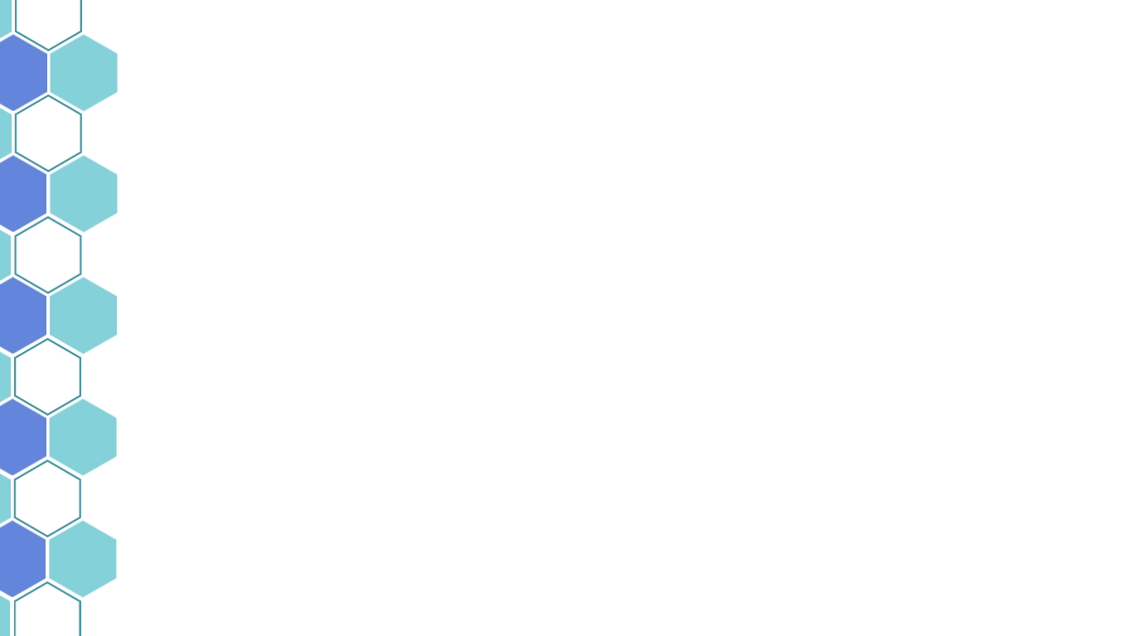
Hardware Block Diagram of FYP
Pi Camera Module 2 for Face Mask Detection
Pi Camera Module 1 for Social Distancing Detection
Raspberry Pi 3B+
MLX90614 Temperature Sensor
Arduino Uno
MAX30102 SpO2 Sensor
Buzzer Module
128x32 OLED LCD Display Module
Electric Door Lock

Slide 4
What is YOLO?
The algorithm applies a single neural network to the full image, and then divides the image into regions and predicts bounding boxes and probabilities for each region.
the algorithm requires only a single forward propagation through a neural network to detect objects.

Slide 5
Why is YOLO algorithm important?
Speed: This algorithm improves the speed of detection
High Accuracy: YOLO is a predictive technique that provides accurate results with minimal background errors.

Slide 6
Three Steps For YOLO
YOLO algorithm works using the following three steps:
Residual blocks
Bounding box regression
Non-maximum suppression using Intersection Over Union (IOU)

Slide 7
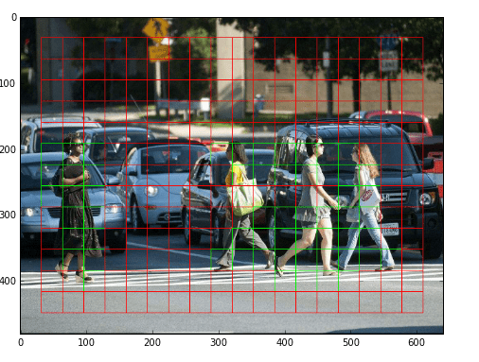
Step 1: Residual Blocks
First, the image is divided into various grids
Every grid cell will detect objects that appear within them
An object is considered to lie in a specific cell only if the center co-ordinates of the bounding box lie in that cell

Slide 8
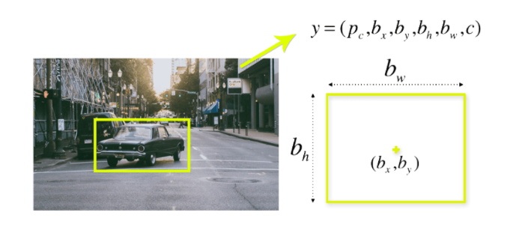
Step 2: Bounding Box Regression
What is a bounding box?
A bounding box is an outline that highlights an object in an image
Every bounding box in the image consists of the following attributes:
Probability that an object lies in the bounding box(pc)
Bounding box width (bw)
Bounding box height (bh)
Confidence score of a class (c)
Bounding box center (bx,by)

Slide 9
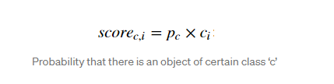
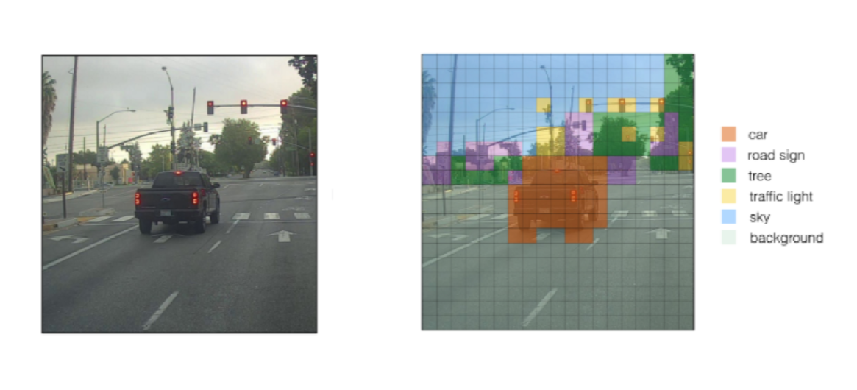
Step 2: Bounding Box Regression
YOLO determines the probability that the cell contains a certain class
The class with the maximum probability is chosen and assigned to that particular grid cell
This image shows the before and after of predicting the class probabilities for each grid cell

Slide 10
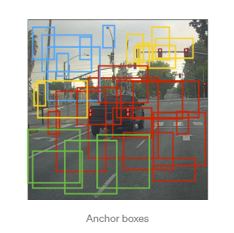
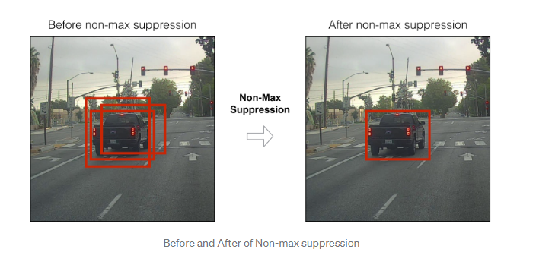
Step 3: Non-maximum suppression using Intersection over Union (IoU)
The purpose of this is to reduce the unnecessary bounding boxes predicted by the algorithm

Slide 11
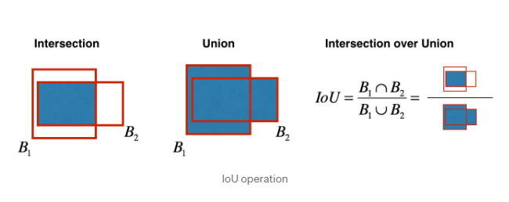
How is Non-maximum suppression done?
Eliminates the bounding boxes that are very close by preforming the IoU (Intersection over Union) with the one having the highest class probability among them.
It calculates the value of IoU for all the bounding boxes respective to the one having the highest class probability, it then rejects the bounding boxes whose value of IoU is greater than a threshold.
Process is repeated for other objects detected in the frame

Slide 12
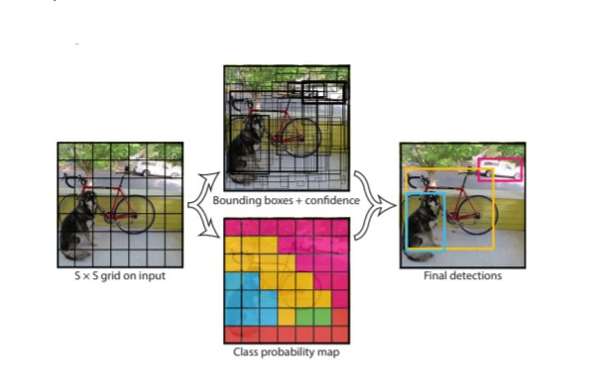
Combination of Three Steps Explained

Slide 13
